Slide 1
At Ease
Jesse Parker
Mark Koren
Lucius Guthrie

Slide 2
Updated Problem
Same problems!
Communication between Tenants and Property Managers is sub par
Maintenance Requests go unnoticed
Rent Pay is a hassle
No peace of mind

Slide 3
Updated Scope
Still built for the Google Android Platform
Still designed for small to medium sized property managers and their tenants
Rent Payments will now only be handled by Stripe
No big changes to project scope

Slide 4
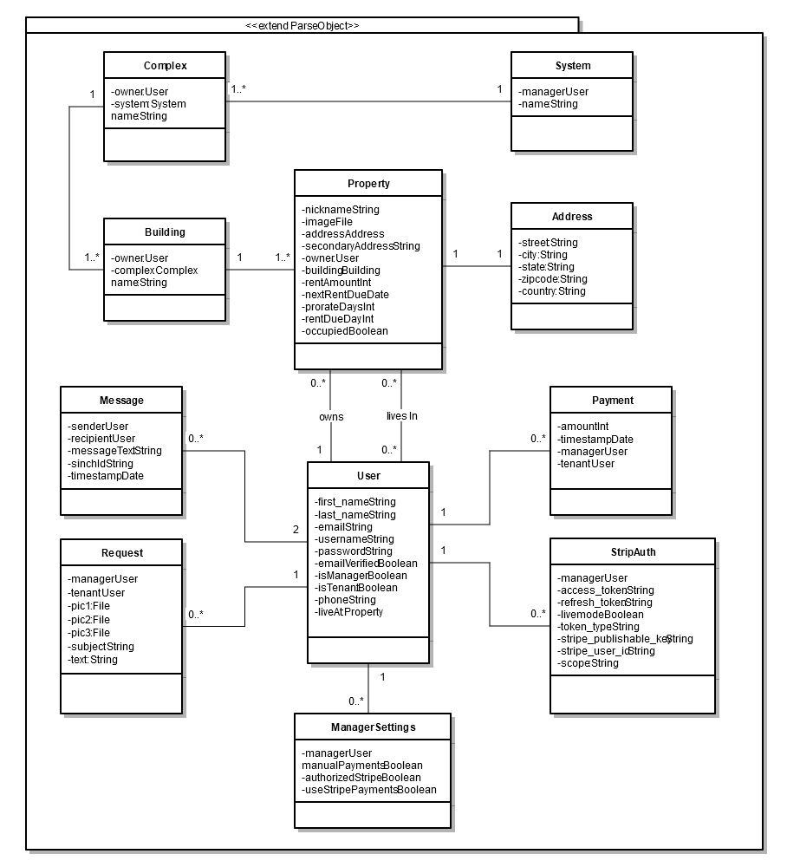
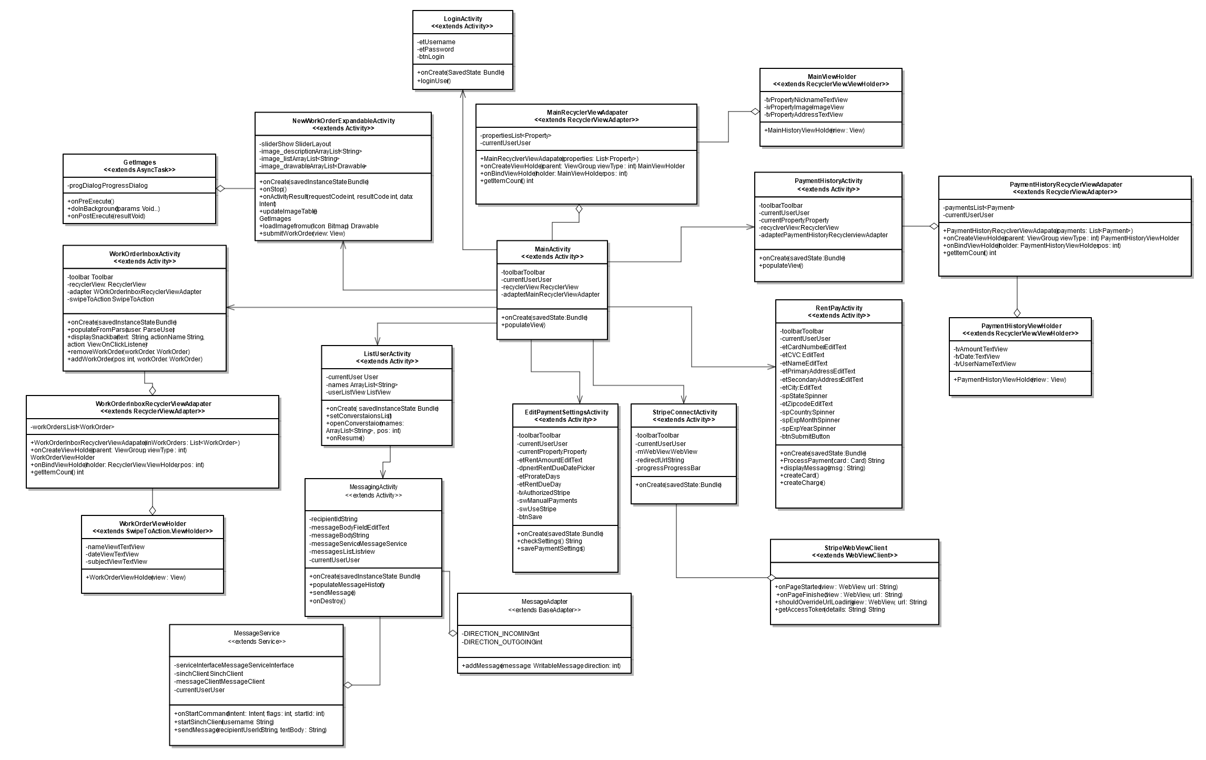
Overview of Class Diagrams

Slide 5
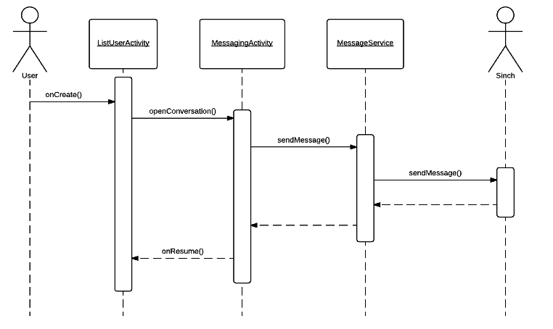
Send Message Sequence Diagram
To send a message, users, both tenants and managers, first navigate to their list of users they are eligible to talk to
A message thread is chosen and the message is sent through the Sinch messaging client

Slide 6
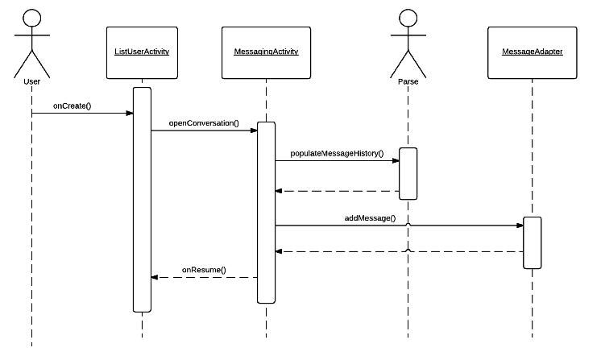
Read Message Sequence Diagram
To read a message, users, both tenants and managers, navigate to their list of users they are eligible to talk to
A message thread is chosen and the Parse database populates the message thread with past read and unread messages

Slide 7
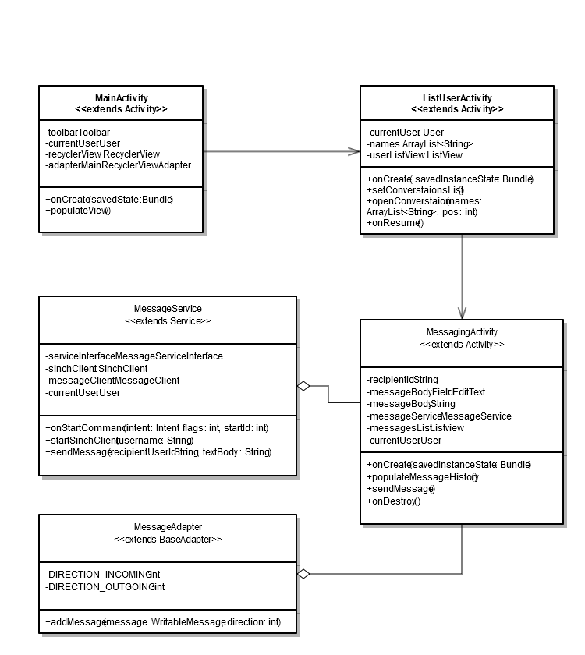
Messaging Classes

Slide 8
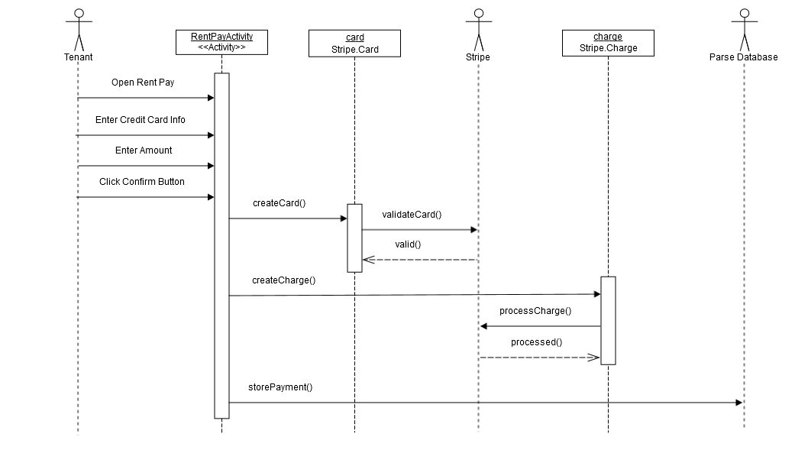
Paying Rent
To Pay rent, tenants must enter their credit card information and enter the amount they want to pay.
Then, by clicking the confirm button, they will kick off the process of making a payment, and storing it in the database.

Slide 9
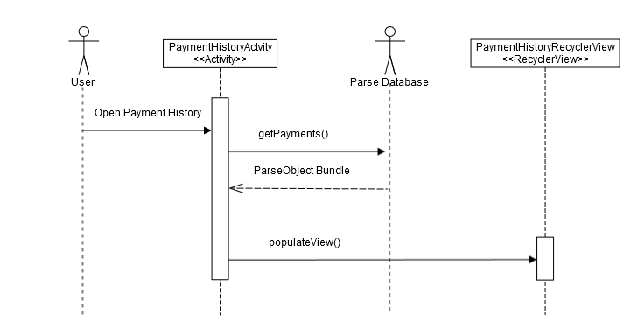
Viewing Payment History
For viewing the payment history, the payments need to be retrieved from the database and displayed on the RecyclerView.

Slide 10
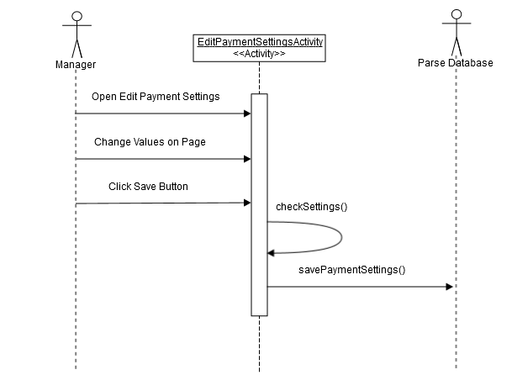
Editing Payment Settings
Managers can change their Payment settings by simply changing the values on the page.
By clicking the save button, the settings will be saved in the database and will take effect immediately.

Slide 11
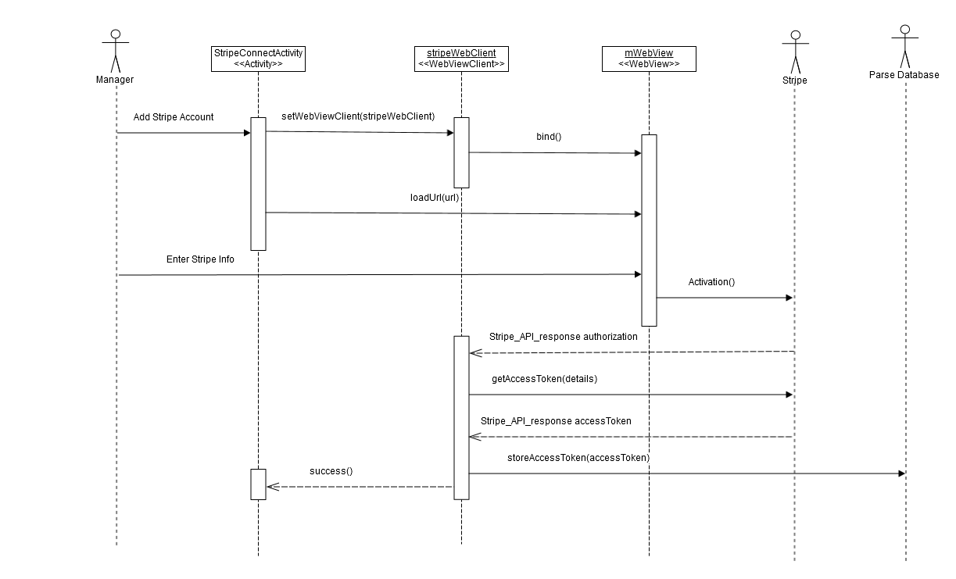
Adding a Payment Account
Managers can connect their stripe account to the At-Ease app by entering their stripe info on the webView which is connected to the stripe sign in page.
After the manager has logged into their stripe info, the activation process will be started and will eventually allow At-Ease to process payments on their behalf

Slide 12
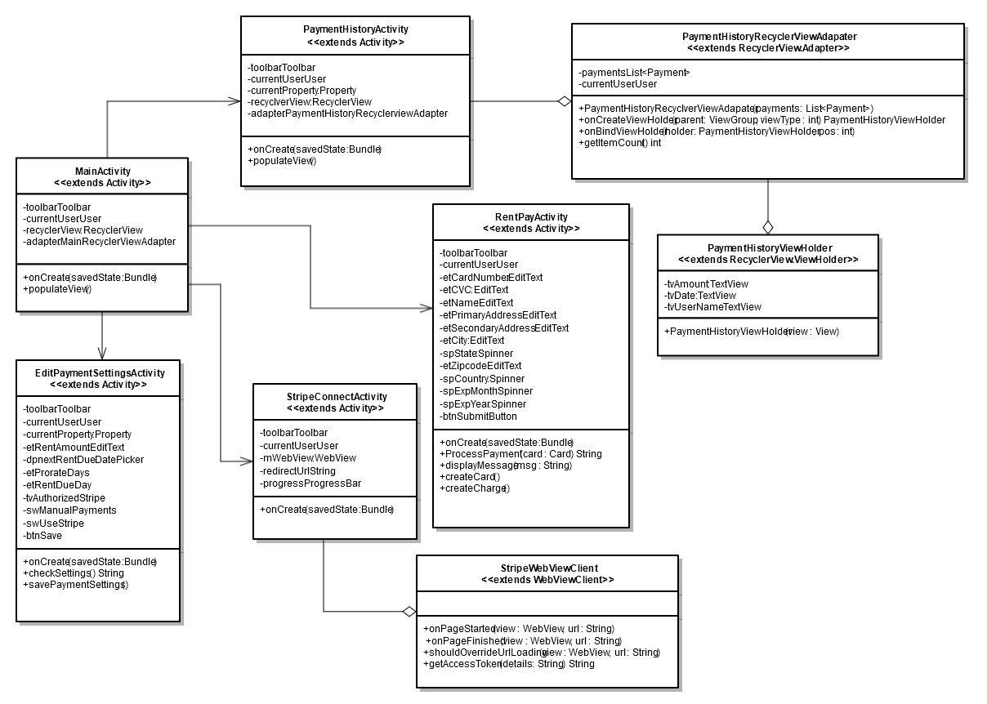
Payment Classes

Slide 13
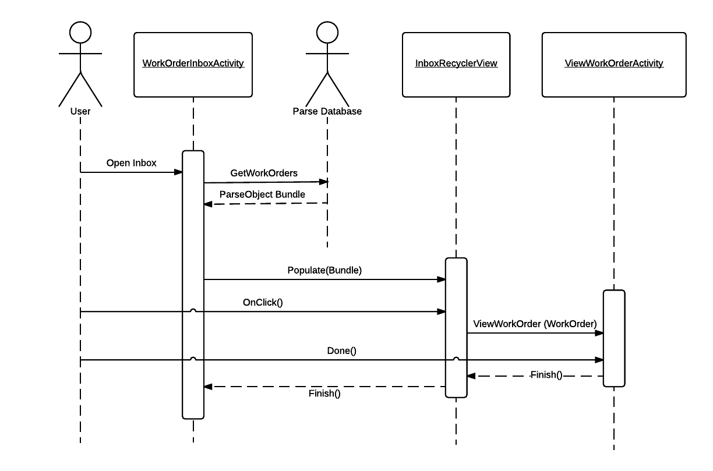
Maintenance Request Sequence Diagram
RecyclerView must populate from the database
This is the basis of most maintenance request sequences

Slide 14
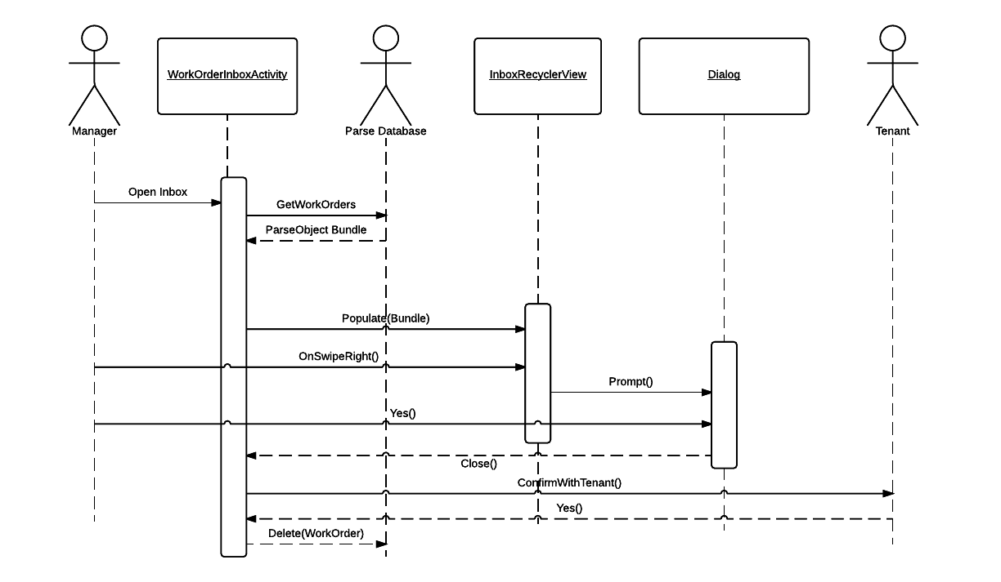
Maintenance Request Sequence Diagram
Closing a request is akin to both parties saying that it has been resolved
Tenant must confirm that a maintenance request can be closed

Slide 15
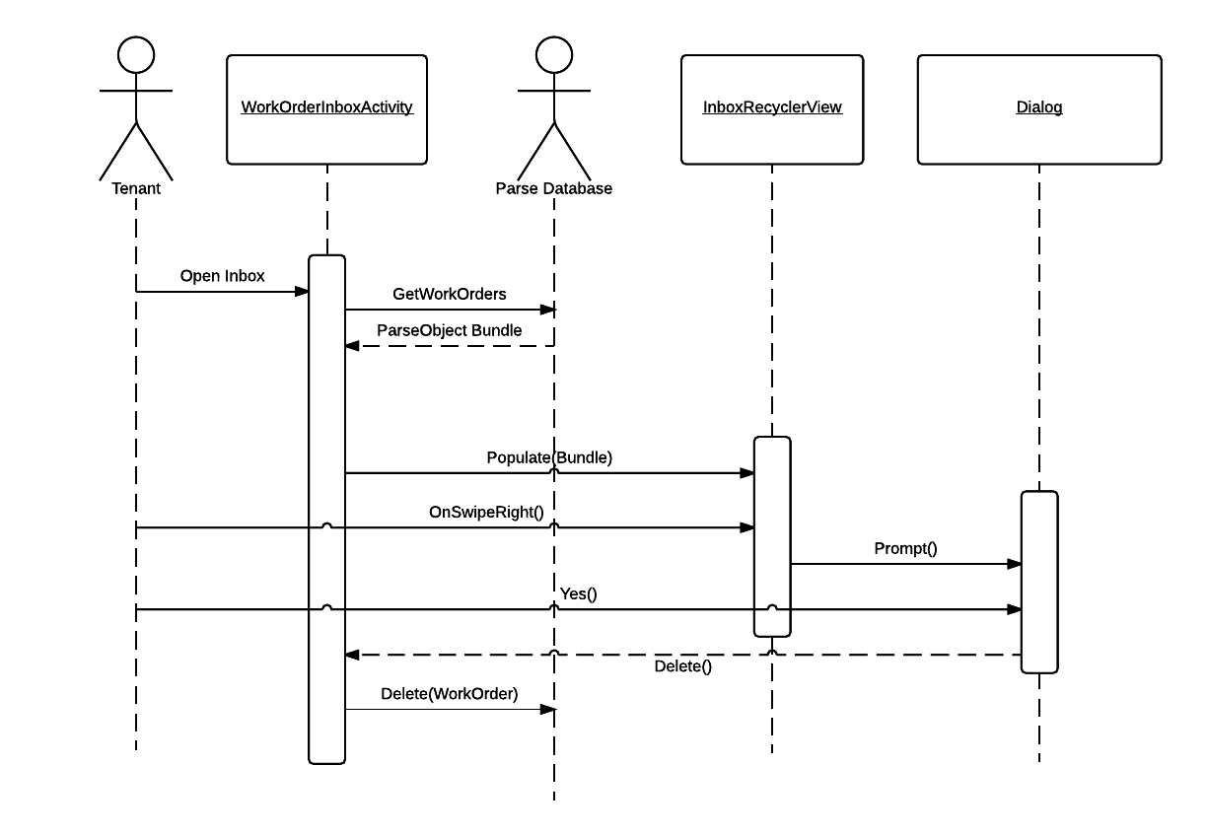
Maintenance Request Sequence Diagram
Requests are currently deleted. A stretch goal is to archive instead

Slide 16
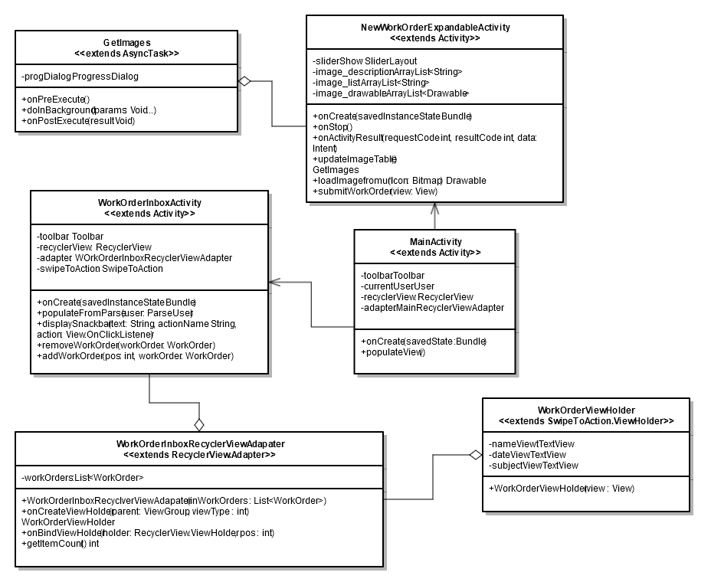
Maintenance Classes

Slide 17
Summary of Changes
Stripe will be the only payment system
We have not made any other changes at this stage of the design.

